Slide 1
Case Study Assignment-1
1.18BCS6091
2.18BCS6095
3.18BCS6096
4.18BCS6097
5.18BCS6098
To understand the global trends in investment.

Slide 2
ABSTRACT
Spark Funds, an asset management company wants to invest in companies. They analyse the global trends in investments to make their decisions.
The company has two minor constraints:-
It wants to invest between 5 to 15 million USD per round of investment
It wants to invest only in English-speaking countries
Spark Funds wants to invest where most other investors are investing.
We have taken real investment data from crunchbase.com.

Slide 3
Problem Solving Strategy
The problem is divided into three Goals of data analysis:
01 Investment type analysis: Comparing the typical investment amounts in
the venture, seed, angel, private equity etc. so that Spark Funds can
choose the type that is best suited for their strategy.
02 Country analysis: Identifying the countries which have been the most
heavily invested in the past. These will be Spark Funds’ favourites as
well.
03 Sector analysis: Understanding the distribution of investments across
the eight main sectors. ( we are interested in the eight 'main sectors'
provided in the mapping file. The two files — companies and rounds2 —
have numerous sub-sector names, hence, we will need to map each
sub-sector to its main sector

Slide 4




Analysis of Check point 1
Before the commencement of check point 1 ,we firstly Imported the packages and merged the dataframes.
Then we Loaded the companies and rounds data into two data frames and named them companies and rounds2 respectively. Following outcomes are then derived from the above dataframes.

Slide 5
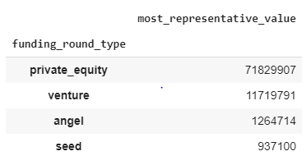
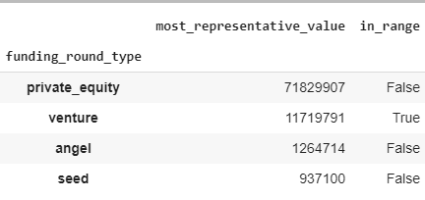
Analysis of Check point 2
Checkpoint 2 was first of the three goals of data analysis – investment type analysis.
Spark Funds wanted to choose one of the four investment types for each potential investment they will make.
Considering the constraints of Spark Funds, we have to decide one funding type which is most suitable for them.
The pasted outcomes shows the results required by Spark Funds.

Slide 6
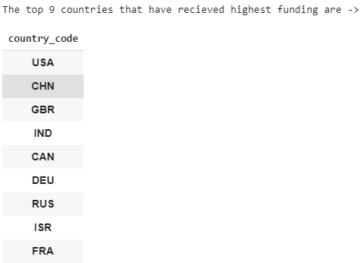
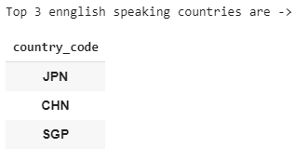
Analysis of Check point 3
This is the second goal of analysis.Spark Funds wants to invest in countries with the highest amount of funding for the chosen
investment type.
We find the top 9 countries by highest funding from all companies
We group the countries and sum the companies who speak English

Slide 7
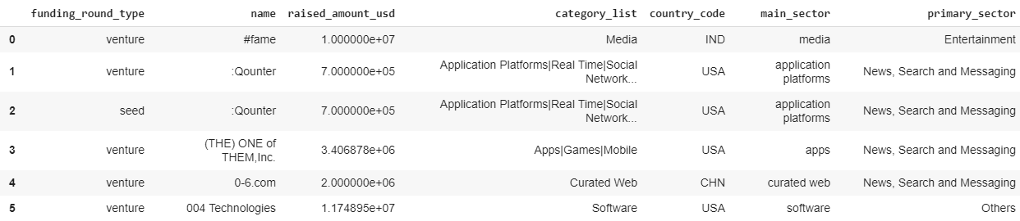
Analysis of Checkpoint 4
This is the third goal of analysis — sector analysis
This is to simplify the analysis by grouping the numerous category lists (named ‘category_list’) in the mapping file.
We map the ‘mapping dataframe and extract the primary sector. Then we merge that into the main dataframe so the required sectors are mapped accordingly

Slide 8
Analysis of Checkpoint 5
the aim is to find out the most heavily invested main sectors in each of the three countries
We group and create 3 new dataframes which have description of the 3 countries separately. After merging, they show the total amount invested, and number of companies of that country who have invested in ‘venture’ sector
We chose venture sector because that is the most appropriate sector for investment because
That falls perfectly in the range of investment
This is the sector where most of the companies have invested

Slide 9
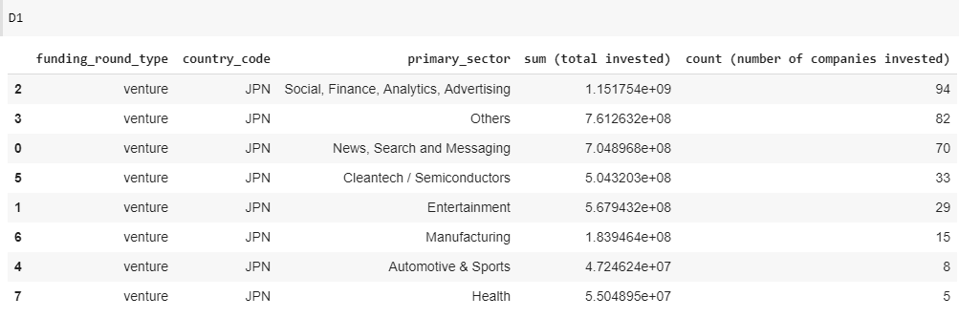
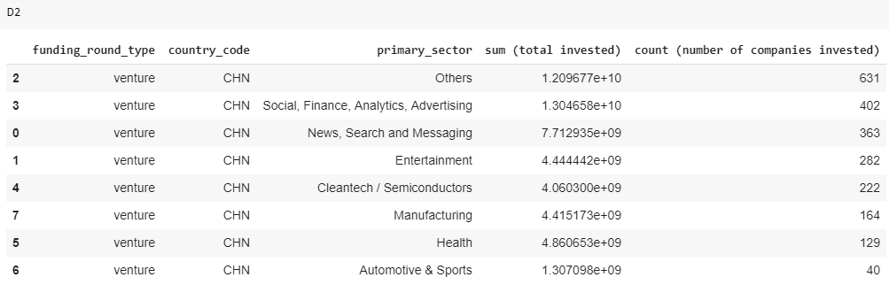

Slide 10
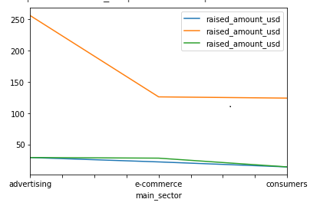
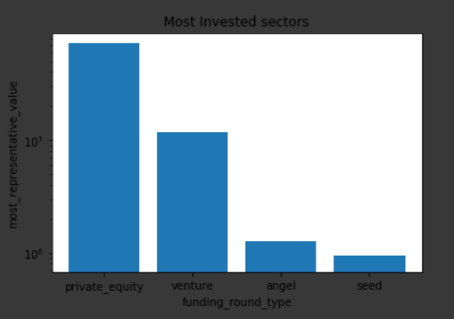
Analysis of Checkpoint 6
1. A plot showing the fraction of total investments (globally) in venture, seed, and private equity, and the average amount of investment in each funding type.
2. A plot showing the top 9 countries against the total amount of investments of funding type FT.
3. A plot showing the number of investments in the top 3 sectors of the top 3 countries on one chart (for the chosen investment type FT)
We have grouped the data according

Slide 11
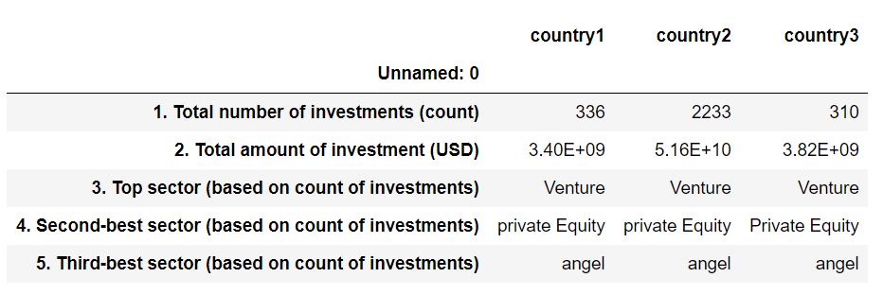
Main Results

